Slide 1
Mitrais Coding Test
Front-End Web Technology

Slide 2
Overview
This code test is to know your technical skill on Front-End Web Technologies. Here you need to create a simple registration page using the following technologies. Source code should be published on your Github public repository.
UI Technologies
HTML 5
CSS (CSS3)
JavaScript Framework, choose one of: Angular, React, Vue
AJAX
Unit test
Web Technologies
RESTful
Server Technologies
Any of your preferred programming languages, PHP, Java, .NET, Javascript
Database
PostgreSQL/MySQL/MS SQLServer

Slide 3
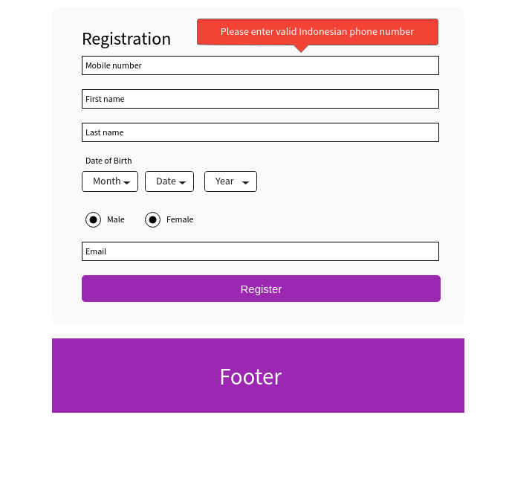
Mobile number is required.
Mobile number should be unique.
Mobile number should validate valid Indonesian phone number.
First name is required
Last name is required
Date of Birth is optional
Gender is optional
Email is required
Email should be unique
When clicked on ‘Register’ button,
Disable (Gray out) Register form as shown in the next slide
If the data saved properly, display login button as shown in the next slide
If there is any error, enable the form and display the error message on top of the form (Register label)

Slide 4
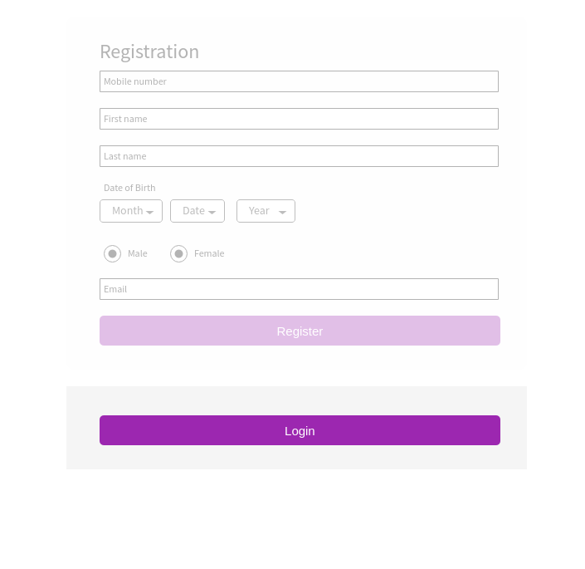
When clicked on the login button, the page should be redirected to login page

